Slide 1


A DASHBOARD WITH CHATBOT FOR EARLY DETECTION OF MENTAL HEALTH ISSUES AMONG UNIVERSITY STUDENTS
BY: AHMAD ASYRAF BIN ZAINUDIN
SUPERVISOR : DR NADIA ABDUL WAHAB

Slide 2
CSP600- PROJECT FORMULATION
CHAPTER 1

Slide 3
CSP600- PROJECT FORMULATION
INTRODUCTION
FINDING
TECHNIQUE
CONTEXT
TECHNOLOGY
TARGET USER
Initial Screening of Mental Health Issue
University Students
Counselors
Dashboard
AI chatbot
Premilinary
Investigation

Slide 4

CSP600- PROJECT FORMULATION
RESEARCH OBJECTIVE
To identify a suitable approach to detect mental health problems among university students by conducting literature.
To develop a web-based and dashboard with a chatbot for initial screening to detect mental health issues among students.
To evaluate the system for early detection of mental health issues among university students by utilizing user experience testing.

Slide 5
CSP600- PROJECT FORMULATION
PROBLEM STATEMENT
THE PROBLEM
The lack of psychiatrists in Malaysia to identify the mental health problem
WHO SUPPORT THE STATMENT
POSSIBLE SOLUTION
There is a significant deficit of mental health professionals, as the demand for mental health services exceeds the available supply
(Abd-alrazaq et al., 2019).
Develop a dashboard for monitoring the mental health issue among university students.
Develop a chatbot system for early screening of mental health problem
The lack of psychiatrists in Malaysia is worrying, as stated by the Ministry of Health's goal to reach a ratio of one psychiatrist for every 30,000 residents nationwide by 2030, or one psychiatrist for every 50,000 Malaysians by 2025 (By CodeBlue, 2021).

Slide 6
CSP600- PROJECT FORMULATION
RESEARCH SCOPE
System:
Dashboard
Chatbot
User:
Counselors
Students

Slide 7
CSP600- PROJECT FORMULATION
SIGNIFICANCE OF STUDY
BENEFITS FOR STUDENTS:
BENEFITS FOR ADMINISTRATORS:
Identification of mental health status level.
Initial support for dealing with mental health issues.
Connection with appropriate mental health professionals.
Access to the best possible treatment.
Simplified recording of student health information.
Easy updating and organizing of profiles and data.
Efficient search functionality for student information.
Early detection feature for notifying students about potential mental health problems.
Effective tracking and identification of students needing mental health assistance.

Slide 8
CSP600- PROJECT FORMULATION
CHAPTER 2

Slide 9
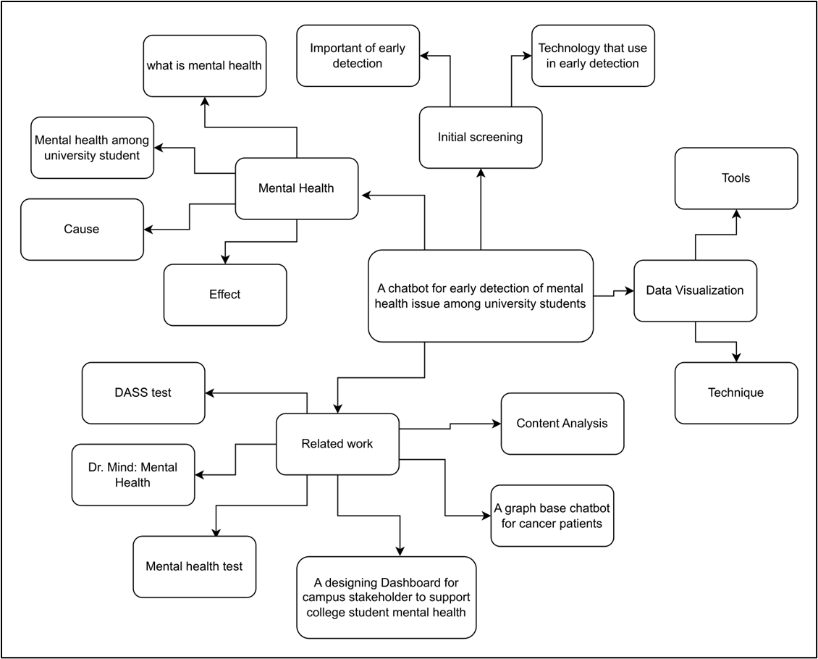
RELEVENCE TREE

Slide 10
RELEVENCE TREE

Slide 11
CSP600- PROJECT FORMULATION
CHAPTER 3

Slide 12



CSP600- PROJECT FORMULATION
METHODOLOGY
METHODOLOGY
Design Science Research Methodology (DSRM)
REASON
PHASE
Standard
Flexible Approach
Awareness of problem
Suggestion
Development
Evaluation
Conclusion

Slide 13
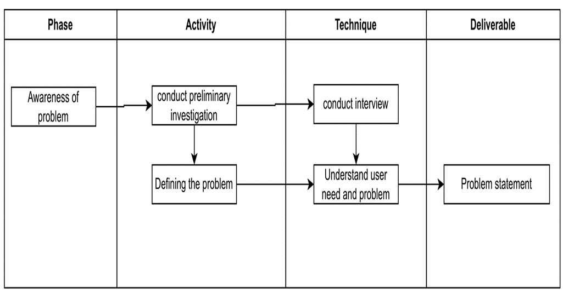
CSP600- PROJECT FORMULATION

Slide 14
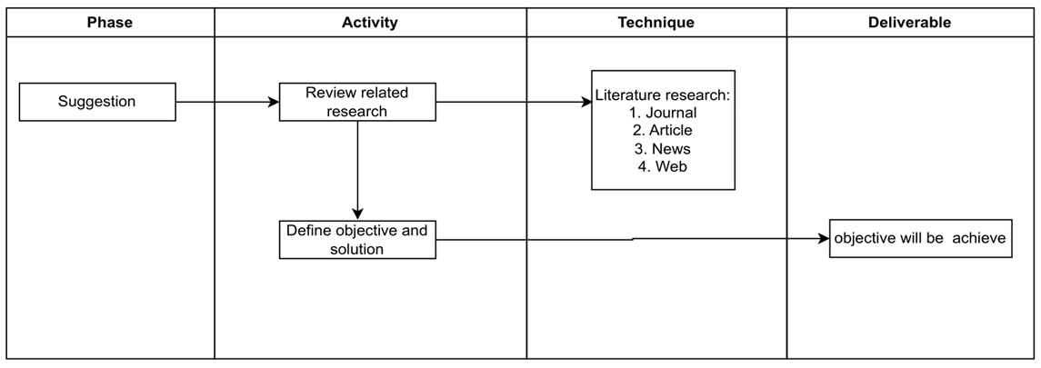
CSP600- PROJECT FORMULATION

Slide 15
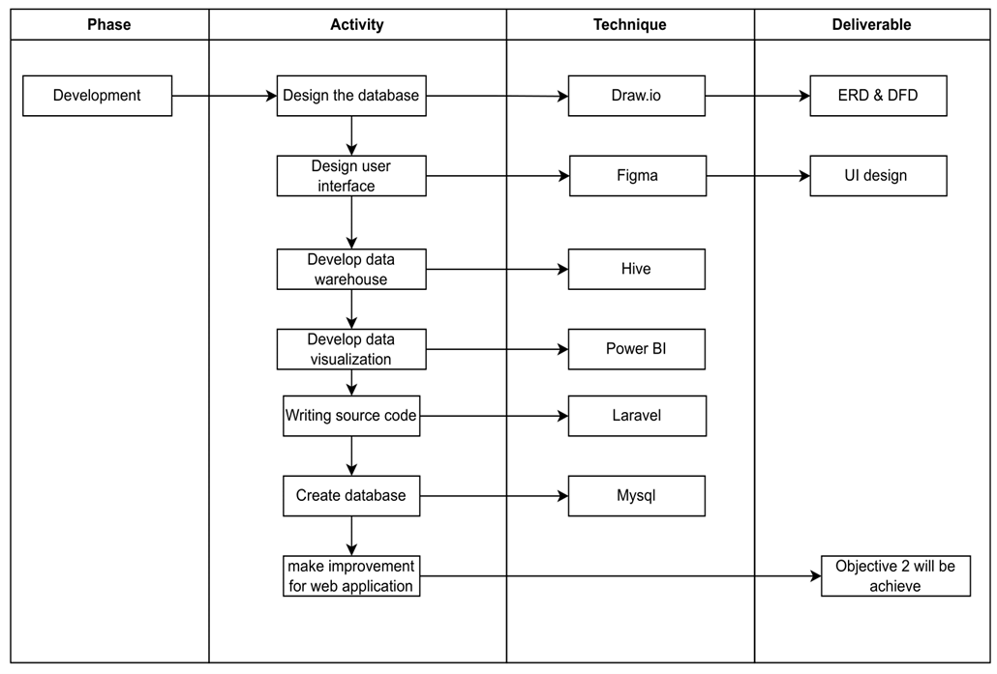
CSP600- PROJECT FORMULATION

Slide 16
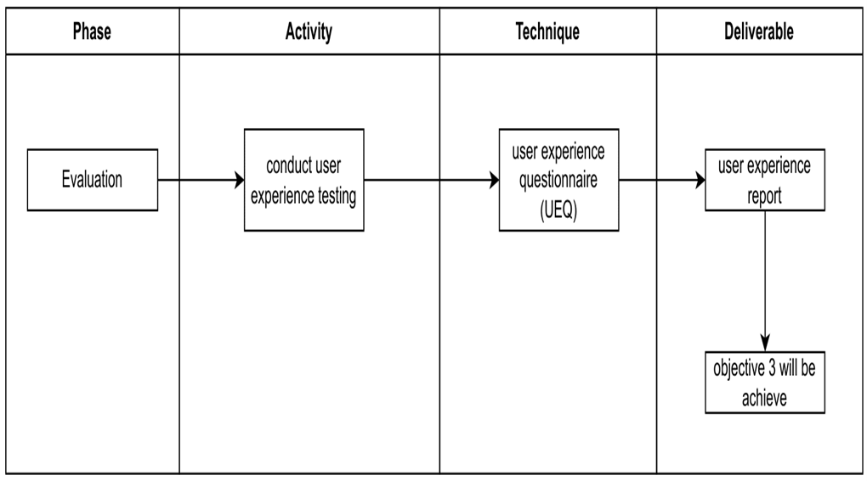
CSP600- PROJECT FORMULATION

Slide 17
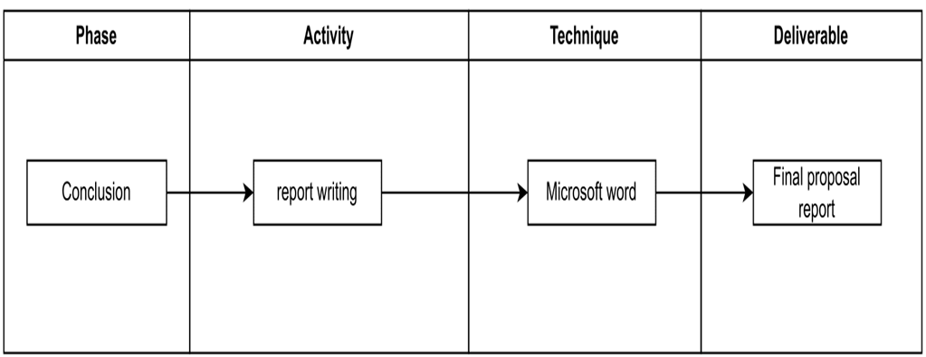
CSP600- PROJECT FORMULATION

Slide 18


CSP600- PROJECT FORMULATION
THANK YOU

